Slide 1
CSCE 5580 – Computer Networks Instructor: Tao Wang

Slide 2

Network Security
What is network security?
Principles of cryptography
Message integrity, authentication
Securing e-mail
Securing TCP connections: TLS
Network layer security: IPsec
Security in wireless and mobile networks
Operational security: firewalls and IDS

Slide 3
What is network security?
confidentiality: only sender, intended receiver should “understand” message contents
sender encrypts message
receiver decrypts message
authentication: sender, receiver want to confirm identity of each other
message integrity: sender, receiver want to ensure message not altered (in transit, or afterwards) without detection
access and availability: services must be accessible and available to users
Notes:
Confidentiality: Keep some content secret from others. Needs encryption.
Message integrity: We want to protect messages from getting changed by others No one should modify the message during communication.
Access and availability: how to make sure that the request is from a genuine user to avoid a DDoS attack.

Slide 4



Friends and enemies: Alice, Bob, Trudy
well-known in network security world
Bob, Alice (lovers!) want to communicate “securely”
Trudy (intruder) may intercept, delete, add messages
Alice
channel
data, control messages
Bob
secure
sender
secure
receiver
data
data
Trudy

Slide 5
Friends and enemies: Alice, Bob, Trudy
Who might Bob and Alice be?
… well, real-life Bobs and Alices!
Web browser/server for electronic transactions (e.g., on-line purchases)
on-line banking client/server
DNS servers
BGP routers exchanging routing table updates
other examples?

Slide 6
There are bad guys (and girls) out there!
Q: What can a “bad guy” do?
A: A lot!
eavesdrop: intercept messages
actively insert messages into connection
impersonation: can fake (spoof) source address in packet (or any field in packet)
hijacking: “take over” ongoing connection by removing sender or receiver, inserting himself in place
denial of service: prevent service from being used by others (e.g., by overloading resources)
Notes:
Passive attack: They don’t do anything they just see.
Active attacker: Like Impersonation: Pretend Alice to Bob or Bob to Alice. Or pretend to go to another site.
Hijacking: If they know session IDs.

Slide 7
Chapter 8 outline
What is network security?
Principles of cryptography
Message integrity, authentication
Securing e-mail
Securing TCP connections: TLS
Network layer security: IPsec
Security in wireless and mobile networks
Operational security: firewalls and IDS

Slide 8
The language of cryptography
Alice’s
encryption
key
Bob’s
decryption
key
K
A
K
B
plaintext
encryption
algorithm
ciphertext
decryption
algorithm
plaintext
m: plaintext message
K_{A}(m): ciphertext, encrypted with key K_{A}
m = K_{B}(K_{A}(m))
Notes:
One way to protect the message is using some methods like encryption.
This is simple.

Slide 9
Breaking an encryption scheme
cipher-text only attack: Trudy has ciphertext she can analyze
two approaches:
brute force: search through all keys
statistical analysis
known-plaintext attack: Trudy has plaintext corresponding to ciphertext
e.g., in monoalphabetic cipher, Trudy determines pairings for a,l,i,c,e,b,o,
chosen-plaintext attack: Trudy can get ciphertext for chosen plaintext
Notes:
Cipher-text-only attack: We will only have cipher text.
Know plain text: The attacker knows plain text corresponding to cipher text.

Slide 10
Symmetric key cryptography
K
K
S
S
plaintext
encryption
algorithm
ciphertext
decryption
algorithm
plaintext
K (m)
S
symmetric key crypto: Bob and Alice share same (symmetric) key: K
e.g., key is knowing substitution pattern in mono alphabetic substitution cipher
Q: how do Bob and Alice agree on key value?

Slide 11
Simple encryption scheme
substitution cipher: substituting one thing for another
monoalphabetic cipher: substitute one letter for another
plaintext: abcdefghijklmnopqrstuvwxyz
ciphertext: mnbvcxzasdfghjklpoiuytrewq
e.g.:
Plaintext: bob. i love you. alice
ciphertext: nkn. s gktc wky. mgsbc
Encryption key: mapping from set of 26 letters
to set of 26 letters

Slide 12
Symmetric key crypto: DES
DES: Data Encryption Standard
US encryption standard [NIST 1993]
56-bit symmetric key, 64-bit plaintext input
block cipher with cipher block chaining
how secure is DES?
DES Challenge: 56-bit-key-encrypted phrase decrypted (brute force) in less than a day
no known good analytic attack
making DES more secure:
3DES: encrypt 3 times with 3 different keys

Slide 13
AES: Advanced Encryption Standard
symmetric-key NIST standard, replaced DES (Nov 2001)
processes data in 128 bit blocks
128, 192, or 256 bit keys
brute force decryption (try each key) taking 1 sec on DES, takes 149 trillion years for AES

Slide 14

Public Key Cryptography
symmetric key crypto:
requires sender, receiver know shared secret key
Q: how to agree on key in first place (particularly if never “met”)?
public key crypto
radically different approach [Diffie-Hellman76, RSA78]
sender, receiver do not share secret key
public encryption key known to all
private decryption key known only to receiver

Slide 15
Public Key Cryptography
+
Bob’s public key
K
B
-
Bob’s private key
K
B
plaintext
message, m
encryption
algorithm
ciphertext
decryption
algorithm
plaintext
+
-
+
K (m)
m = K (K (m))
B
B
B
Wow - public key cryptography revolutionized 2000-year-old (previously only symmetric key) cryptography!
similar ideas emerged at roughly same time, independently in US and UK (classified)

Slide 16
Public key encryption algorithms
requirements:
+
.
-
.
1
need K ( ) and K ( ) such that
B
B
-
+
K (K (m)) = m
B
B
+
2
given public key K , it should be impossible to compute private key K
B
-
B
RSA: Rivest, Shamir, Adelson algorithm

Slide 17
RSA in practice: session keys
exponentiation in RSA is computationally intensive
DES is at least 100 times faster than RSA
use public key crypto to establish secure connection, then establish second key – symmetric session key – for encrypting data
session key, K_{S}
Bob and Alice use RSA to exchange a symmetric session key K_{S}
once both have K_{S}, they use symmetric key cryptography

Slide 18
Chapter 8 outline
What is network security?
Principles of cryptography
Authentication, message integrity
Securing e-mail
Securing TCP connections: TLS
Network layer security: IPsec
Security in wireless and mobile networks
Operational security: firewalls and IDS

Slide 19
Authentication
Goal: Bob wants Alice to “prove” her identity to him
Protocol ap1.0: Alice says “I am Alice”
“I am Alice”
failure scenario??

Slide 20
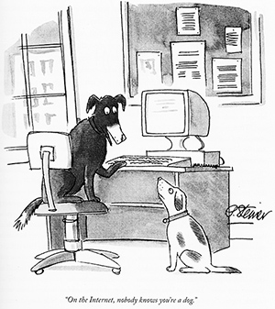
Authentication
Goal: Bob wants Alice to “prove” her identity to him
Protocol ap1.0: Alice says “I am Alice”
in a network, Bob can not “see” Alice, so Trudy simply declares herself to be Alice
“I am Alice”

Slide 21
Authentication: another try
Goal: Bob wants Alice to “prove” her identity to him
Protocol ap2.0: Alice says “I am Alice” in an IP packet containing her source IP address
Alice’s
IP address
“I am Alice”
failure scenario??

Slide 22
Authentication: another try
Goal: Bob wants Alice to “prove” her identity to him
Protocol ap2.0: Alice says “I am Alice” in an IP packet containing her source IP address
Trudy can create
a packet “spoofing”
Alice’s address
Alice’s
IP address
“I am Alice”

Slide 23
Authentication: a third try
Goal: Bob wants Alice to “prove” her identity to him
Protocol ap3.0: Alice says “I am Alice” and sends her secret password to “prove” it.
Alice’s
IP addr
Alice’s
password
“I am Alice”
failure scenario??
Alice’s
IP addr
OK

Slide 24
Authentication: a third try
Goal: Bob wants Alice to “prove” her identity to him
Protocol ap3.0: Alice says “I am Alice” and sends her secret password to “prove” it.
playback attack: Trudy records Alice’s packet
and later
plays it back to Bob
Alice’s
IP addr
Alice’s
password
“I am Alice”
Alice’s
IP addr
Alice’s
password
“I am Alice”
Alice’s
IP addr
OK

Slide 25
Authentication: a modified third try
Goal: Bob wants Alice to “prove” her identity to him
Protocol ap3.0: Alice says “I am Alice” and sends her encrypted secret password to “prove” it.
Alice’s
IP addr
encrypted
password
“I am Alice”
failure scenario??
Alice’s
IP addr
OK

Slide 26
Authentication: a modified third try
Goal: Bob wants Alice to “prove” her identity to him
Protocol ap3.0: Alice says “I am Alice” and sends her encrypted secret password to “prove” it.
Alice’s
IP addr
encrypted
password
“I am Alice”
playback attack still works: Trudy records Alice’s packet
and later plays it back to Bob
Alice’s
IP addr
encrypted
password
“I am Alice”
Alice’s
IP addr
OK

Slide 27
Authentication: a fourth try
Goal: avoid playback attack
nonce: number (R) used only once-in-a-lifetime
protocol ap4.0: to prove Alice “live”, Bob sends Alice nonce, R
Alice must return R, encrypted with shared secret key
“I am Alice”
R
K (R)
Bob know Alice is live, and only Alice knows key to encrypt nonce, so it must be Alice!
A-B
Failures, drawbacks?

Slide 28
Authentication: ap5.0
ap4.0 requires shared symmetric key - can we authenticate using public key techniques?
ap5.0: use nonce, public key cryptography
“I am Alice”
R
Bob computes
+
-
-
K
(K (R)) = R
K (R)
A
A
A
and knows only Alice could have the private key, that encrypted R such that
Send me your public key
+
K (R)
+
-
A
K
A
(K (R)) = R
A

Slide 29
Authentication: ap5.0 – there’s still a flaw!
man (or woman) in the middle attack: Trudy poses as Alice (to Bob) and as Bob (to Alice)
I am Alice
I am Alice
?
R
-
K (R)
T
R
Where are mistakes made here?
Send me your public key
-
+
K (R)
K
Bob computes
A
T
+
-
Send me your public key
K
(K (R)) = R,
+
T
T
K
authenticating
Trudy as Alice
A
Trudy recovers m:
+
+
-
+
K (m)
Trudy recovers Bob’s m:
m = K (K (m))
Bob sends a personal message, m to Alice
-
+
K (m)
T
T
m = K (K (m))
A
T
A
A
sends m to Alice encrypted with Alice’s public key
and she and Bob meet a week later in person and discuss m, not knowing Trudy knows m

Slide 30
Public key Certification Authorities (CA)
certification authority (CA): binds public key to particular entity, E
entity (person, website, router) registers its public key with CE provides “proof of identity” to CA
CA creates certificate binding identity E to E’s public key
certificate containing E’s public key digitally signed by CA: CA says “this is E’s public key”
Bob’s
public
key
digital
signature
(encrypt)
+
+
K
K
B
B
CA’s
private
key
-
certificate for Bob’s public key, signed by CA
Bob’s
identifying information
K
CA

Slide 31
Public key Certification Authorities (CA)
when Alice wants Bob’s public key:
gets Bob’s certificate (Bob or elsewhere)
apply CA’s public key to Bob’s certificate, get Bob’s public key
+
digital
signature
(decrypt)
Bob’s
public
key
K
+
B
K
B
CA’s
public
key
+
K
CA

Slide 32
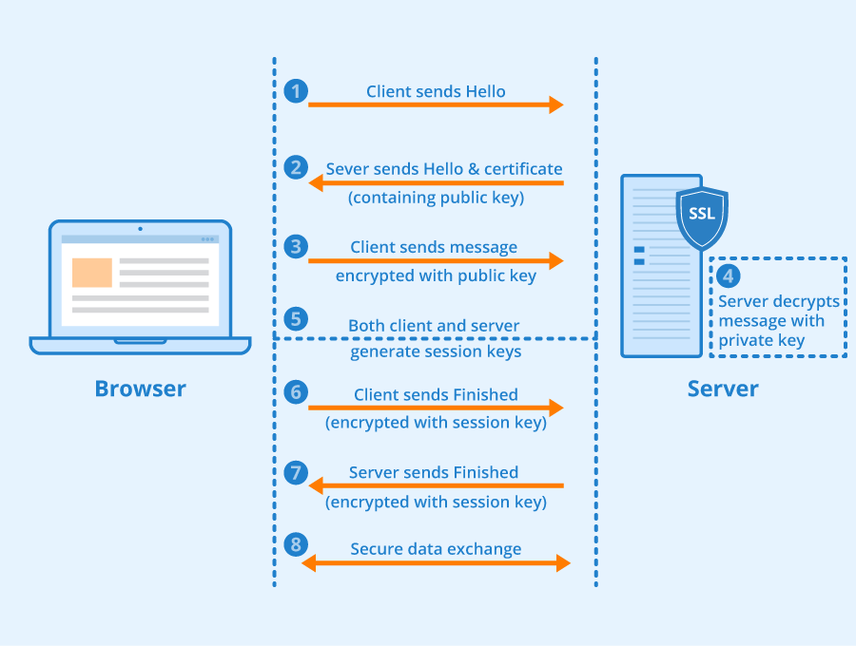
HTTPS

Slide 33
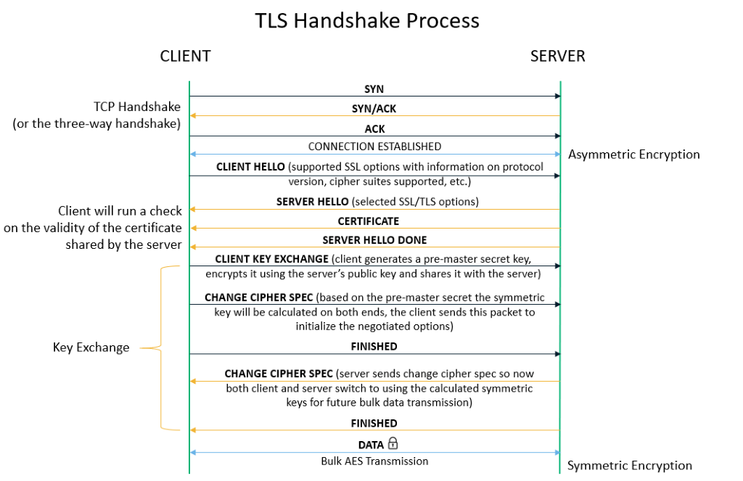
HTTPS

Slide 34
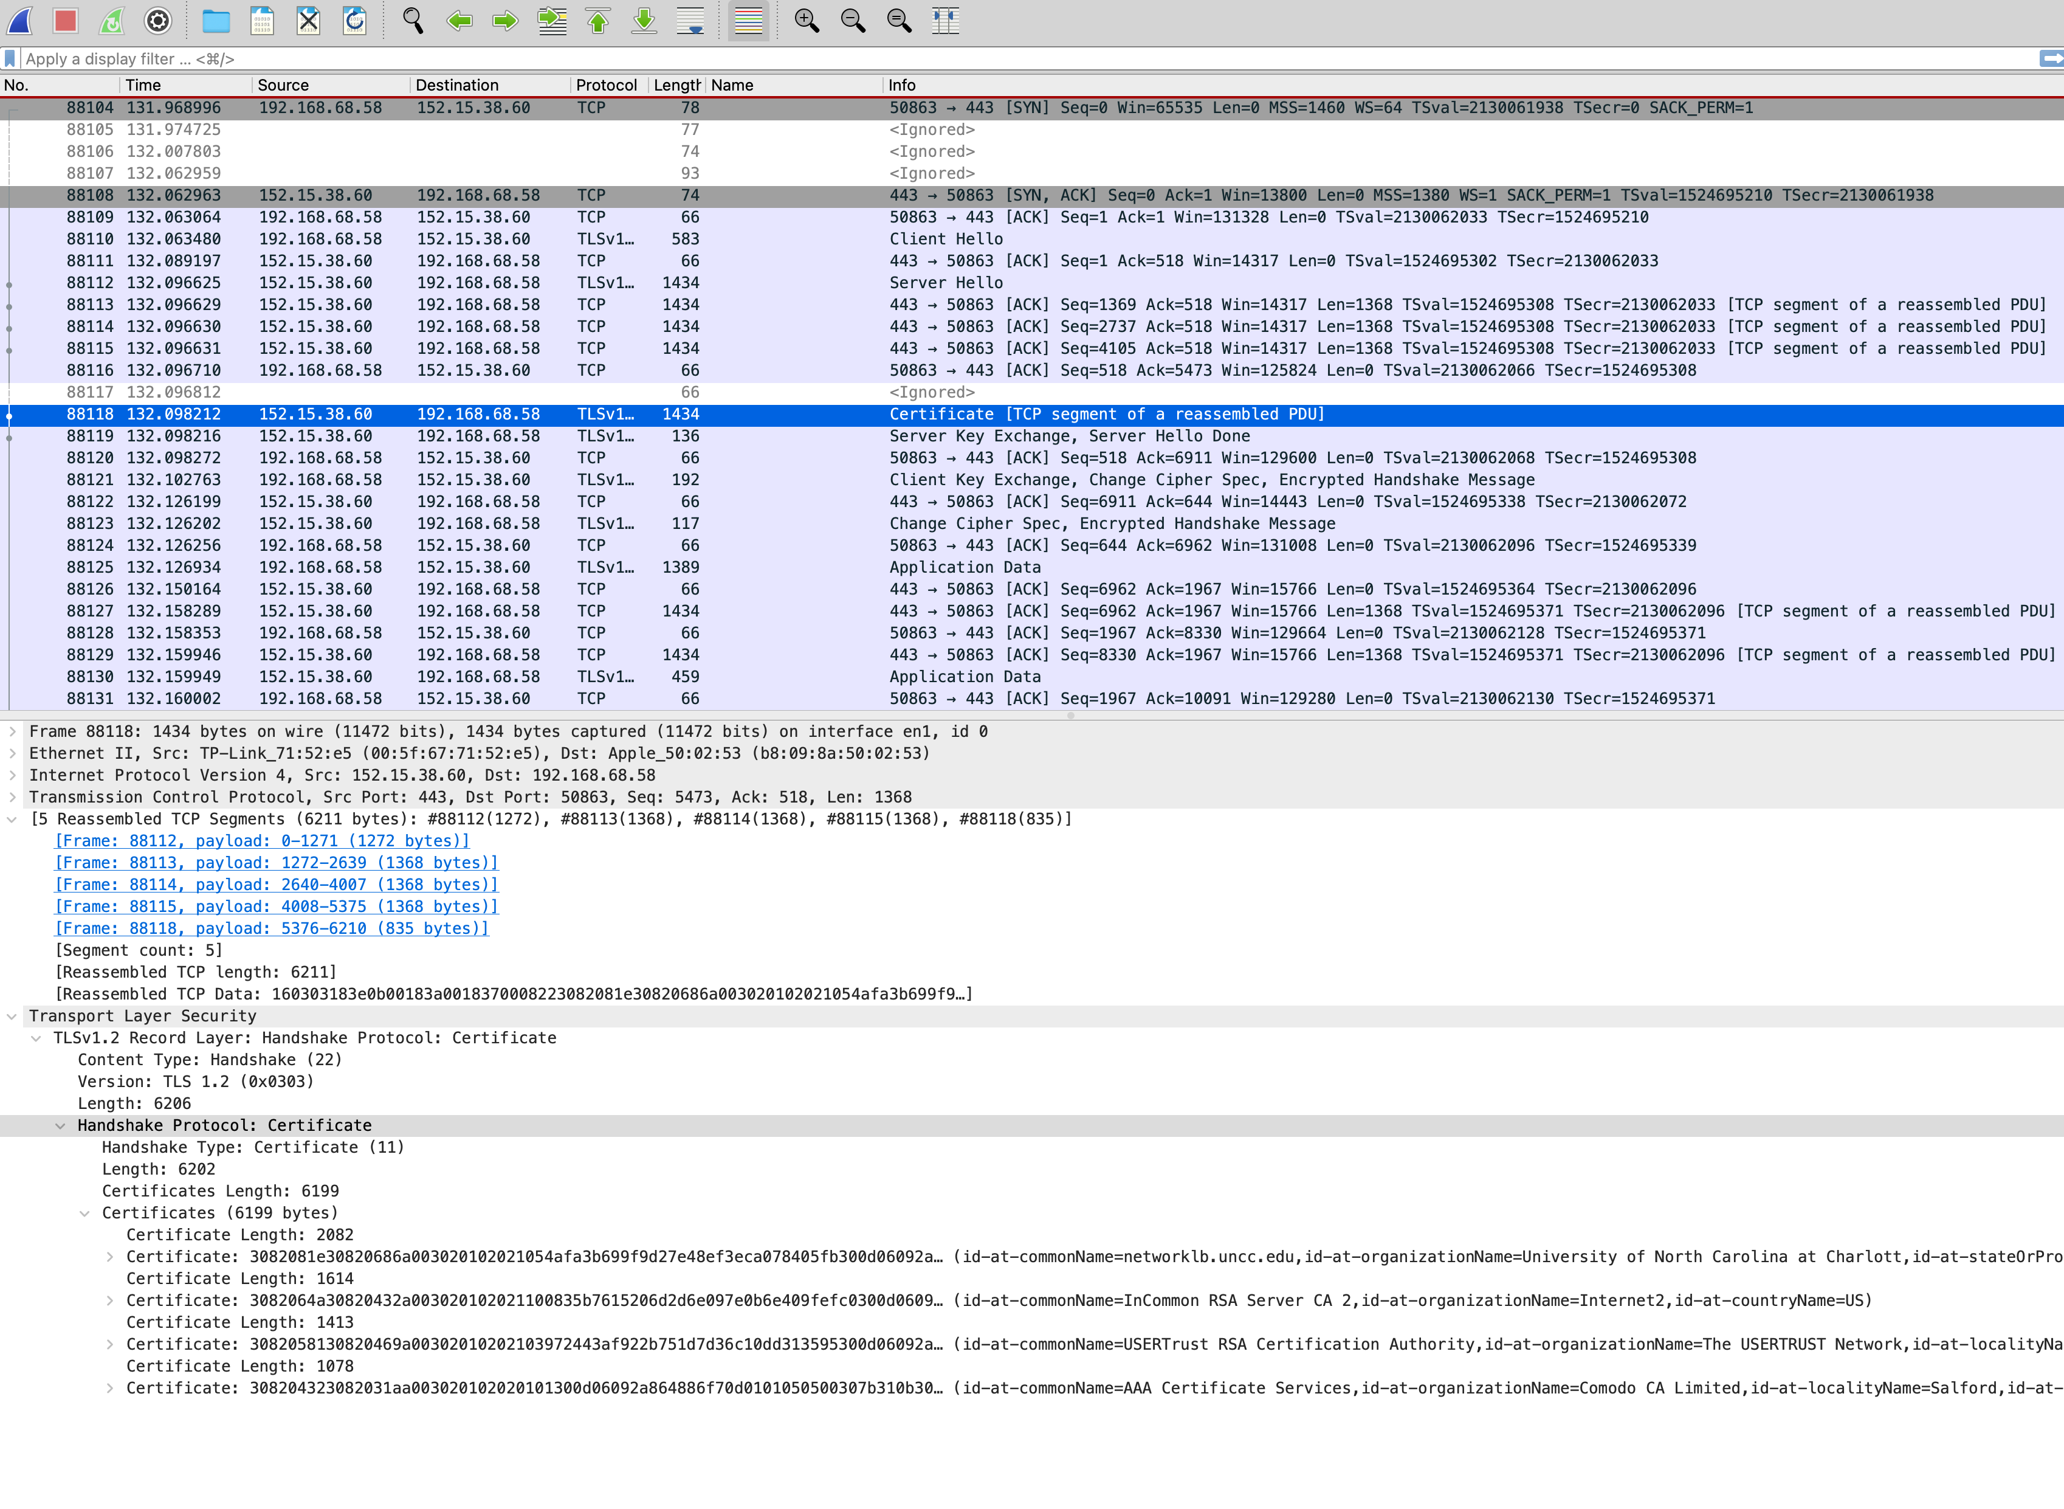

Slide 35
Chapter 8 outline
What is network security?
Principles of cryptography
Authentication, message integrity
Securing e-mail
Securing TCP connections: TLS
Network layer security: IPsec
Security in wireless and mobile networks
Operational security: firewalls and IDS

Slide 36

Digital signatures
cryptographic technique analogous to hand-written signatures:
sender (Bob) digitally signs document: he is document owner/creator.
verifiable, nonforgeable: recipient (Alice) can prove to someone that Bob, and no one else (including Alice), must have signed document
simple digital signature for message m:
Bob signs m by encrypting with his private key K_{B}, creating “signed” message, K_{B}⁻(m)
-
Bob’s private
key
-
Bob’s message, m
K
m,K
(m)
B
B
Dear Alice
Oh, how I have missed you. I think of you all the time! …(blah blah blah)
Bob
Dear Alice
Oh, how I have missed you. I think of you all the time! …(blah blah blah)
Bob
Public key
encryption
algorithm
-
K
(m)
B
Notes:
If we get an email from @unt.edu, then that is verified.
The public key is to encrypt, and the private key is to decrypt.
But in the digital signature, if we want to prove that the message is generated by Bob, then Bob encrypts using the private key, and users will verify by decrypting the public keys.

Slide 37
Digital signatures
-
suppose Alice receives msg m, with signature: m, K_{B}(m)
Alice verifies m signed by Bob by applying Bob’s public key K_{B} to K_{B}(m) then checks K_{B}(K_{B}(m) ) = m.
If K_{B}(K_{B}(m) ) = m, whoever signed m must have used Bob’s private key
+
-
+
-
+
-
Alice thus verifies that:
Bob signed m
no one else signed m
Bob signed m and not m’
non-repudiation:
Alice can take m, and signature K_{B}(m) to court and prove that Bob signed m
-

Slide 38
Message digests
computationally expensive to public-key-encrypt long messages
goal: fixed-length, easy- to-compute digital “fingerprint”
apply hash function H to m, get fixed size message digest, H(m)
large
message
m
H: Hash
Function
H(m)
Hash function properties:
many-to-1
produces fixed-size msg digest (fingerprint)
given message digest x, computationally infeasible to find m such that x = H(m)
Notes:
The hash function of any sized file is 256 bits.

Slide 39
Internet checksum: poor crypto hash function
Internet checksum has some properties of hash function:
produces fixed length digest (16-bit sum) of message
is many-to-one
but given message with given hash value, it is easy to find another message with same hash value:
message
ASCII format
message
ASCII format
I O U 1
0 0 . 9
9 B O B
49 4F 55 31
30 30 2E 39
39 42 D2 42
I O U 9
0 0 . 1
9 B O B
49 4F 55 39
30 30 2E 31
39 42 D2 42
B2 C1 D2 AC
different messages
but identical checksums!
B2 C1 D2 AC
Notes:
For hash functions, one important property is that we should not easily find out that two messages have the same hash result.
Given a message, we can find out the hash function easily, but vice versa should not be done, it should be computationally infusible.

Slide 40
Hash function algorithms
MD5 hash function widely used (RFC 1321)
computes 128-bit message digest in 4-step process.
arbitrary 128-bit string x, appears difficult to construct msg m whose MD5 hash is equal to x
SHA-1 is also used
US standard [NIST, FIPS PUB 180-1]
160-bit message digest

Slide 41
Chapter 8 outline
What is network security?
Principles of cryptography
Authentication, message integrity
Securing e-mail
Securing TCP connections: TLS
Network layer security: IPsec
Security in wireless and mobile networks
Operational security: firewalls and IDS

Slide 42
Secure e-mail: confidentiality
Alice wants to send confidential e-mail, m, to Bob.
K_{S}
.
K_{S}(m )
K_{S}(m )
.
m
K_{S}( )
K_{S}( )
m
+
-
Internet
K_{S}
.
-
.
+
K_{S}
K_{B}( )
+
+
K_{B}( )
K_{B}(K_{S} )
K_{B}(K_{S} )
+
-
K_{B}
K_{B}
Alice:
generates random symmetric private key, K_{S}
encrypts message with K_{S} (for efficiency)
also encrypts K_{S} with Bob’s public key
sends both K_{S}(m) and K⁺_{B}(K_{S}) to Bob

Slide 43
Secure e-mail: confidentiality (more)
Alice wants to send confidential e-mail, m, to Bob.
K_{S}
.
K_{S}(m )
K_{S}(m )
.
m
K_{S}( )
K_{S}( )
m
+
-
Internet
K_{S}
.
-
.
+
K_{S}
K_{B}( )
+
+
K_{B}( )
K_{B}(K_{S} )
K_{B}(K_{S} )
+
-
K_{B}
K_{B}
Bob:
uses his private key to decrypt and recover K_{S}
uses K_{S} to decrypt K_{S}(m) to recover m

Slide 44
Secure e-mail: integrity, authentication
Alice wants to send m to Bob, with message integrity, authentication
-
+
K_{A}
K_{A}
.
.
-
-
.
-
K_{A}(H(m))
K_{A}(H(m))
+
H(m )
m
H( )
K_{A}( )
K_{A}( )
+
-
compare
Internet
.
m
H( )
H(m )
m
Alice digitally signs hash of her message with her private key, providing integrity and authentication
sends both message (in the clear) and digital signature

Slide 45
Secure e-mail: integrity, authentication
Alice sends m to Bob, with confidentiality, message integrity, authentication
-
K_{A}
-
confidentiality
.
.
K_{A}(H(m))
m
-
K_{S}
H( )
K_{A}( )
.
K_{S}(m )
+
K_{S}( )
m
+
Internet
message integrity, authentication
.
K_{S}
+
K_{B}( )
+
K_{B}(K_{S} )
+
K_{B}
Alice uses three keys: her private key, Bob’s public key, new symmetric key
What are Bob’s complementary actions?

Slide 46
Chapter 8 outline
What is network security?
Principles of cryptography
Authentication, message integrity
Securing e-mail
Securing TCP connections: TLS
Network layer security: IPsec
Security in wireless and mobile networks
Operational security: firewalls and IDS

Slide 47

Firewalls
firewall
isolates organization’s internal network from larger Internet, allowing some packets to pass, blocking others
administered
network
public
Internet
trusted “good guys”
untrusted “bad guys”
firewall
Notes:
Sometimes, it also blocks traffic, which is not allowed by the organization.
Ex, ChatGPT is blocked on Paycom’s systems.
IMPORTANT for EXAM.
Design a firewall in exam

Slide 48
Firewalls: why
prevent denial of service attacks:
SYN flooding: attacker establishes many bogus TCP connections, no resources left for “real” connections
prevent illegal modification/access of internal data
e.g., attacker replaces CIA’s homepage with something else
allow only authorized access to inside network
set of authenticated users/hosts
three types of firewalls:
stateless packet filters
stateful packet filters
application gateways
Notes:
Security
Stateless: Most simple firewall, it will verify the packets individually, (Ex: Don’t allow UDP packets)
Stateful: Instead of checking the packet independently, we could also track its connections. (Ex: Allow only active connections).
Application gateways: This is very specific to the application. Each application has its own firewall. Different applications, different rules.

Slide 49
Stateless packet filtering
Should arriving packet be allowed in? Departing packet let out?
internal network connected to Internet via router firewall
filters packet-by-packet, decision to forward/drop packet based on:
source IP address, destination IP address
TCP/UDP source, destination port numbers
ICMP message type
TCP SYN, ACK bits
Notes:
This is based on the packet.
Do not consider dependencies between packets.
Ex: Chatgpt cannot be opened in the Paycom system.
Block port number example 80. This will block all packets from port 80.
Used by small organizations.

Slide 50
Stateless packet filtering: example
Should arriving packet be allowed in? Departing packet let out?
example 1: block incoming and outgoing datagrams with IP protocol field = 17 and with either source or dest port = 23
result: all incoming, outgoing UDP flows and telnet connections are blocked
example 2: block inbound TCP segments with ACK=0
result: prevents external clients from making TCP connections with internal clients, but allows internal clients to connect to outside
Notes:
IP protocol field: Specifies what kind of server is used (TCP or UDP).
The port number is used to identify the applications.
Ex 1 is UDP, and 2 is TCP.
ACK=0 is usually a SYN request.

Slide 51
Stateless packet filtering: more examples
Policy | Firewall Setting
no outside Web access | drop all outgoing packets to any IP address, port 80
no incoming TCP connections, except those for institution’s public Web server only. | drop all incoming TCP SYN packets to any IP except 130.207.244.203, port 80
prevent Web-radios from eating up the available bandwidth. | drop all incoming UDP packets - except DNS and router broadcasts.
prevent your network from being used for a smurf DoS attack. | drop all ICMP packets going to a “broadcast” address (e.g. 130.207.255.255)
prevent your network from being tracerouted | drop all outgoing ICMP TTL expired traffic
Notes:
Things to know when designing a stateless protocol.
Port=80 is an HTTP request.
UDP packets don’t have any congestion control; it uses the whole bandwidth of the network.
When we send an ICMP request, the device will reply with the device details.

Slide 52
Access Control Lists
ACL: table of rules, applied top to bottom to incoming packets: (action, condition) pairs: looks like OpenFlow forwarding (Ch. 4)!
action | source address | dest address | protocol | source port | dest port | flag bit
allow | 222.22/16 | outside of 222.22/16 | TCP | > 1023 | 80 | any
allow | outside of 222.22/16 | 222.22/16 | TCP | 80 | > 1023 | ACK
allow | 222.22/16 | outside of 222.22/16 | UDP | > 1023 | 53 | ---
allow | outside of 222.22/16 | 222.22/16 | UDP | 53 | > 1023 | ----
deny | all | all | all | all | all | all
Notes:
1st: Internal to outside is allowed
2nd: Allow the outside devices to content to internal through TCP.
ACK: This must be some response, it is not a request.
3rd: Port 53: For DNS request. DNS to get an IP address is allowed.
These are 4 steps to access external/outside web service.
Block all other traffics.
This website will only allow those 4.

Slide 53
Stateful packet filtering
stateless packet filter: heavy handed tool
admits packets that “make no sense,” e.g., dest port = 80, ACK bit set, even though no TCP connection established:
action | source address | dest address | protocol | source port | dest port | flag bit
allow | outside of 222.22/16 | 222.22/16 | TCP | 80 | > 1023 | ACK
stateful packet filter: track status of every TCP connection
track connection setup (SYN), teardown (FIN): determine whether incoming, outgoing packets “makes sense”
timeout inactive connections at firewall: no longer admit packets
Notes:
For stateless, we don't check connections, for stateful, we check connections to ensure it's not fake.
Box: We want to make sure that it’s a response, not a request. This could also be fake; we don’t know because it is stateless. We cannot verify.

Slide 54
Stateful packet filtering
ACL augmented to indicate need to check connection state table before admitting packet
action | source address | dest address | proto | source port | dest port | flag bit | check connection
allow | 222.22/16 | outside of 222.22/16 | TCP | > 1023 | 80 | any
allow | outside of 222.22/16 | 222.22/16 | TCP | 80 | > 1023 | ACK | x
allow | 222.22/16 | outside of 222.22/16 | UDP | > 1023 | 53 | ---
allow | outside of 222.22/16 | 222.22/16 | UDP | 53 | > 1023 | ---- | x
deny | all | all | all | all | all | all
Notes:
We maintain a table; if there is a match, then it's not fake and accepted.
If we cannot find a match in the connection table, then drop it.
If there is no response, then there is no connection.
This is to check whether the response corresponds to the previous request.

Slide 55
Application gateways
filter packets on application data as well as on IP/TCP/UDP fields.
example: allow select internal users to telnet outside
host-to-gateway
telnet session
application
gateway
router and filter
gateway-to-remote
host telnet session
1. require all telnet users to telnet through gateway.
2. for authorized users, gateway sets up telnet connection to dest host
gateway relays data between 2 connections
3. router filter blocks all telnet connections not originating from gateway
Notes:
If we have specific requirements for specific applications, we can set up a firewall for that application.

Slide 56
Limitations of firewalls, gateways
IP spoofing: router can’t know if data “really” comes from claimed source
if multiple apps need special treatment, each has own app. gateway
client software must know how to contact gateway
e.g., must set IP address of proxy in Web browser
filters often use all or nothing policy for UDP
tradeoff: degree of communication with outside world, level of security
many highly protected sites still suffer from attacks

Slide 57
Intrusion detection systems
packet filtering:
operates on TCP/IP headers only
no correlation check among sessions
IDS: intrusion detection system
deep packet inspection: look at packet contents (e.g., check character strings in packet against database of known virus, attack strings)
examine correlation among multiple packets
port scanning
network mapping
DoS attack
Notes:
Use patterns to identify different attacks.
It's more popular in today's network.
We can also host our website on our servers but they are costly and not so secure and fast.
So host on amazon and google’s server.

Slide 58
Network Security (summary)
basic techniques…...
cryptography (symmetric and public key)
message integrity
end-point authentication
…. used in many different security scenarios
secure email
secure transport (TLS)
IP sec
802.11, 4G/5G
operational security: firewalls and IDS

